Slide 1

University of North Texas
CSCE 2110
Foundations of Data Structures
Hashing

Slide 2
Dictionary ADT
Data structure with just three basic operations:
findItem (i): find item with key (identifier) i
insert (i): insert i into the dictionary
remove (i): delete i
Just like words in a Dictionary
Where do we use them:
Symbol tables for compiler
Customer records (access by name)
Games (positions, configurations)
Spell checkers, etc.
Notes:
今天我们要学习一个新的抽象数据类型——Dictionary ADT（字典抽象数据类型）。
顾名思义，‘字典’这个名字非常形象：你在字典里查单词，就像我们在计算机中查找一个数据项。 它的关键特征是——通过一个 key（键）来访问一个 item（值）。
Dictionary ADT 定义了三个最基本的操作：
”findItem(i) “通过键 i 查找对应的项。例如通过学生学号找到学生的信息。”
insert(i) “插入一个新的项，比如添加一个新的用户或商品记录。”
remove(i) “删除一个项，比如删除一个已经注销的账户。”

Slide 3
How to Implement a Dictionary?
Sequences
ordered
unordered
Binary Search Trees
Hashtables
Notes:
我们该怎么实现一个字典呢？
最简单的方式，是用**序列（sequence）**来实现。也就是说，把所有的键值对放在一个表或数组里
另一种方式，是用 二叉搜索树（BST） 来实现字典。BST 的好处是：查找、插入、删除的平均复杂度都是 O(log n)；
数据是自动排序的，非常适合范围查询（range query）。
但是它也有缺点——如果树退化成链表（比如插入的键值本身有序），效率就会降到 O(n)。 当然，我们可以用平衡树（如 AVL）来解决这个问题。
最后一种，也是我们今天要重点讲的，就是 Hash Table（哈希表）

Slide 4
Hashing
An important and widely useful technique for implementing data structures such as dictionaries
Constant time per operation (on the average)
Worst case time proportional to the size of the set for each operation (just like array and chain implementation)
Notes:
Hashing 是一种非常重要、也非常实用的技术，广泛应用于各种数据结构，比如我们刚刚提到的 Dictionary。
在理想情况下，哈希操作的时间复杂度是 O(1) ——也就是常数时间。这意味着无论我们有 10 个元素还是 100 万个元素， 平均来说，查找、插入、删除的时间几乎不变。
在最坏情况下，哈希表的性能会退化。那么时间复杂度就会退化成 O(n)

Slide 5
Basic Idea
Use hash function to map keys into positions in a hash table Constant time per operation (on the average)
Ideally
If element e has key k and h is hash function, then e is stored in position h(k) of table
To search for e, compute h(k) to locate position. If no element, dictionary does not contain e.
Notes:
Hashing 的核心在于一个东西——hash function（哈希函数）
哈希函数的任务非常简单： 👉 把一个 key（键）转换成一个整数， 👉 这个整数就是哈希表（hash table）里的位置（position）
“理想情况下是这样的： 假设我们有一个元素 e，它的 key 是 k， 而我们定义的哈希函数是 h。
那么我们就把 e 存放在表中第 h(k) 个位置上。
当我们想查找 e 的时候， 只需要重新计算一次哈希函数——也就是 h(k)， 直接跳到那个位置去看一眼就行。
如果那个位置有元素并且匹配成功，就找到了； 如果没有，那说明字典中并不存在这个元素。 整个过程几乎是瞬间完成。”

Slide 6
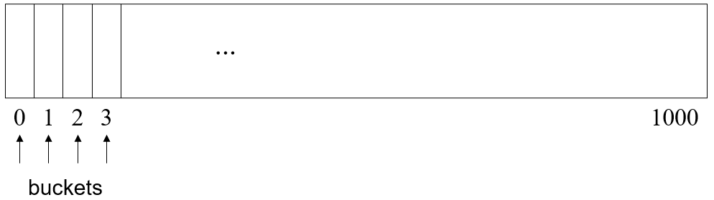
Example
Dictionary Student Records
Keys are ID numbers (1000 - 2000), no more than 1001 students
Hash function: h(k) = k-1000 maps ID into distinct table positions 0-1000
array table[1001]
hash table
Notes:
那现在我们来看一个具体的例子，看看哈希函数是如何真正工作的。
“假设我们要做一个学生记录的字典（Dictionary Student Records）。每个学生都有一个唯一的 ID 编号，这些编号在 1000 到 2000 之间。
我们可以定义一个非常简单的哈希函数：$h\left(k\right)=k−1000$ 这个函数的意思是, 把学生的 ID 减去 1000，就得到它在表中的位置。
这样，每一个学生的记录都能被唯一地映射到表中的一个格子。

Slide 7
Analysis (Ideal Case)
O(b) time to initialize hash table (b number of positions or buckets in hash table)
O(1) time to perform insert, remove, search
Notes:
首先，建立一个哈希表需要一点初始化时间。假设哈希表中有 b 个位置，也叫 buckets（桶）。我们要先创建这些存储空间，让它们都处于空状态。
这个过程需要 O(b) 的时间——也就是说，初始化的时间和桶的数量成正比。一旦表建立完成，后面的操作就会非常快。
在理想情况下，哈希表能在 O(1) 的时间内完成插入（insert）、删除（remove）、查找（search）。
什么意思呢？就是无论表中有 10 个元素还是 100 万个元素，平均查找、插入、删除的时间几乎不变。
为什么？因为我们不需要一个一个地找，而是直接用哈希函数算出元素的位置——一步到位。

Slide 8
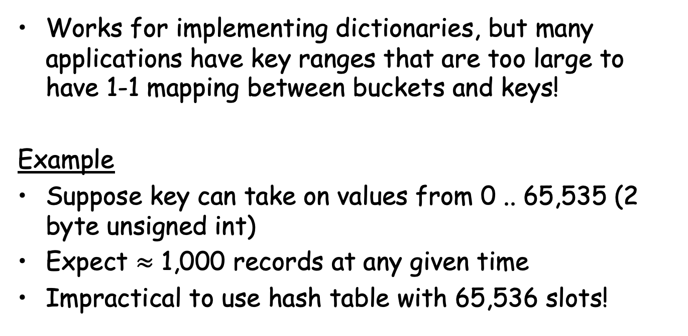
Ideal Case is Unrealistic
Works for implementing dictionaries, but many applications have key ranges that are too large to have 1-1 mapping between buckets and keys!
Example
Suppose key can take on values from 0 .. 65,535 (2 byte unsigned int)
Expect $≈$ 1,000 records at any given time
Impractical to use hash table with 65,536 slots!

Slide 9
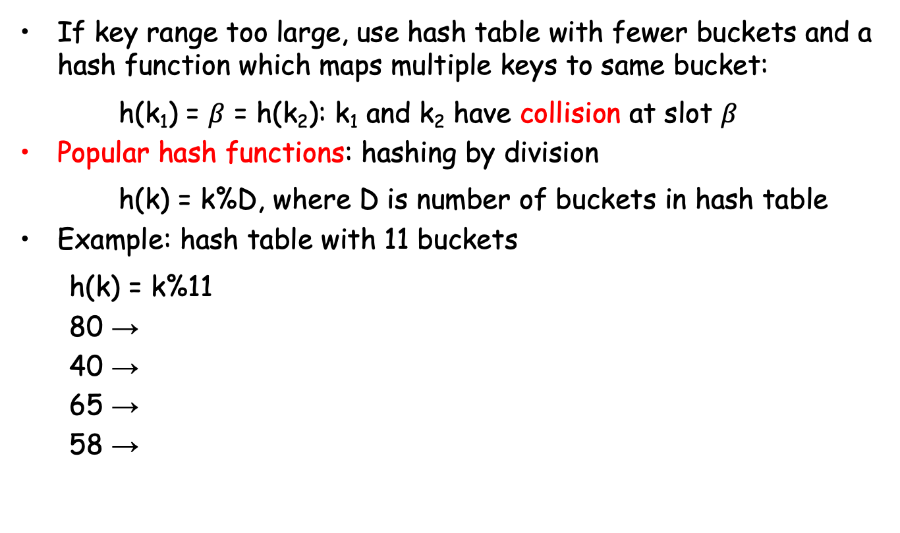
Hash Functions
If key range too large, use hash table with fewer buckets and a hash function which maps multiple keys to same bucket:
h(k₁) = $β$ = h(k₂): k₁ and k₂ have collision at slot $β$
Popular hash functions: hashing by division
h(k) = k%D, where D is number of buckets in hash table
Example: hash table with 11 buckets
h(k) = k%11
80 →
40 →
65 →
58 →

Slide 10
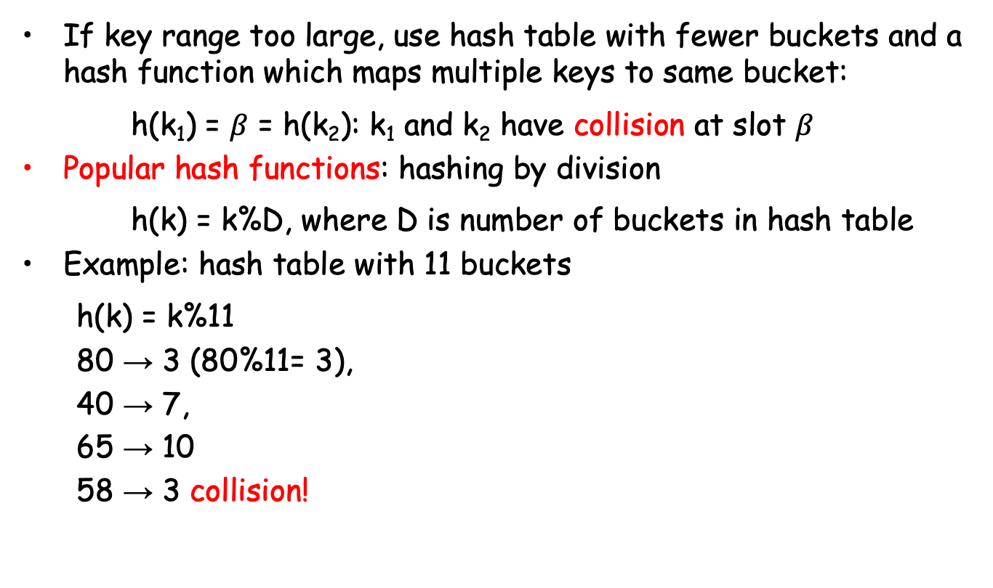
Hash Functions
If key range too large, use hash table with fewer buckets and a hash function which maps multiple keys to same bucket:
h(k₁) = $β$ = h(k₂): k₁ and k₂ have collision at slot $β$
Popular hash functions: hashing by division
h(k) = k%D, where D is number of buckets in hash table
Example: hash table with 11 buckets
h(k) = k%11
80 → 3 (80%11= 3),
40 → 7,
65 → 10
58 → 3 collision!

Slide 11
Collision Resolution Policies
Two classes:
(1) Open hashing, a.k.a. separate chaining
(2) Closed hashing, a.k.a. open addressing
Difference has to do with whether collisions are stored outside the table (open hashing) or whether collisions result in storing one of the records at another slot in the table (closed hashing)

Slide 12
Closed Hashing
Associated with closed hashing is a rehash strategy:
“If we try to place x in bucket h(x) and find it occupied, find alternative location h₁(x), h₂(x), etc. Try each in order, if none empty table is full,”
h(x) is called home bucket
Simplest rehash strategy is called linear hashing
h_{i}(x) = (h(x) + i) % D
(usually, i starts from 1 and is increased by 1 every time)
In general, our collision resolution strategy is to generate a sequence of hash table slots (probe sequence) that can hold the record; test each slot until find empty one (probing)

Slide 13
Example Linear (Closed) Hashing
D=8, keys a, b, c, d have hash values h(a)=3, h(b)=0, h(c)=4, h(d)=3

Slide 14
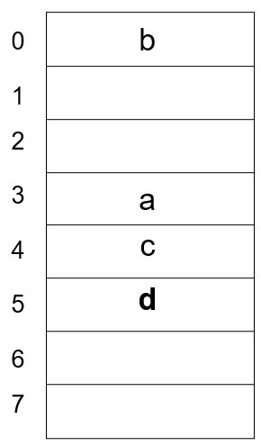
Example Linear (Closed) Hashing
D=8, keys a, b, c, d have hash values h(a)=3, h(b)=0, h(c)=4, h(d)=3

Slide 15
Example Linear (Closed) Hashing
D=8, keys a, b, c, d have hash values h(a)=3, h(b)=0, h(c)=4, h(d)=3
Where do we insert d? 3 already filled

Slide 16
Example Linear (Closed) Hashing
D=8, keys a, b, c, d have hash values h(a)=3, h(b)=0, h(c)=4, h(d)=3
Where do we insert d? 3 already filled
Probe sequence using linear hashing:
h1(d) = (h(d)+1)%8 = 4%8 = 4
h2(d) = (h(d)+2)%8 = 5%8 = 5*
h3(d) = (h(d)+3)%8 = 6%8 = 6
etc.
7, 0, 1, 2
Wraps around the beginning
of the table!

Slide 17
Example Linear (Closed) Hashing
D=8, keys a, b, c, d have hash values h(a)=3, h(b)=0, h(c)=4, h(d)=3
Where do we insert d? 3 already filled
Probe sequence using linear hashing:
h1(d) = (h(d)+1)%8 = 4%8 = 4
h2(d) = (h(d)+2)%8 = 5%8 = 5*
h3(d) = (h(d)+3)%8 = 6%8 = 6
etc.
7, 0, 1, 2
Wraps around the beginning
of the table!

Slide 18
Operations Using Linear Hashing
findItem
Examine h(k), h₁(k), h₂(k), …, until we find k or home bucket
insert
Examine h(k), h₁(k), h₂(k), …, until we find an empty bucket or home bucket
remove
Perform findIterm and then delete if it is in the hash table
May need to reorganize table after many deletions

Slide 19
Performance Analysis - Worst Case
Initialization: O(b), b# of buckets
Insert and search: O(n), n number of elements in table; all n key values have same home bucket
Not better than linear list for maintaining dictionary!

Slide 20
Improved Collision Resolution
Linear probing: h_{i}(x) = (h(x) + i) % D
all buckets in table will be candidates for inserting a new record before the probe sequence returns to home position
clustering of records, leads to long probing sequences

Slide 21
Improved Collision Resolution
Linear probing: h_{i}(x) = (h(x) + i) % D
all buckets in table will be candidates for inserting a new record before the probe sequence returns to home position
clustering of records, leads to long probing sequences
Linear probing with skipping: h_{i}(x) = (h(x) + ic) % D
c is a constant other than 1
records with adjacent home buckets will not follow same probe sequence

Slide 22
Improved Collision Resolution
Linear probing: h_{i}(x) = (h(x) + i) % D
all buckets in table will be candidates for inserting a new record before the probe sequence returns to home position
clustering of records, leads to long probing sequences
Linear probing with skipping: h_{i}(x) = (h(x) + ic) % D
c is a constant other than 1
records with adjacent home buckets will not follow same probe sequence
(Pseudo) Random probing: h_{i}(x) = (h(x) + r_{i}) % D
r_{i} is the i^{th} value in a random permutation of numbers from 1 to D-1
insertions and searches use the same sequence of “random” numbers

Slide 23
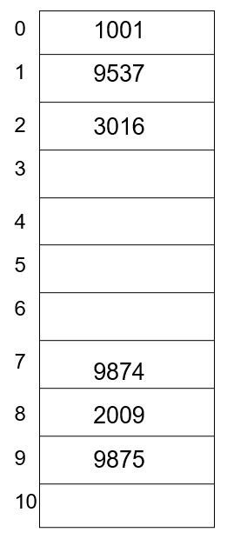
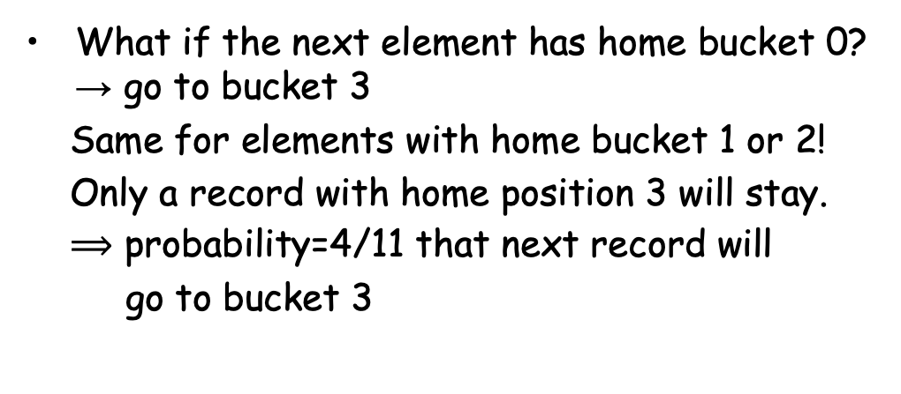
Example
Hash function: h(k) = k%11
What if the next element has home bucket 0? → go to bucket 3
Same for elements with home bucket 1 or 2!
Only a record with home position 3 will stay.
$⟹$ probability=4/11 that next record will
go to bucket 3
Similarly, records hashing to 7, 8, 9 will end up in 10
Only records hashing to 4 will end up in position 4 (probability=? that next record will go to bucket 4); same for 5 and 6

Slide 24
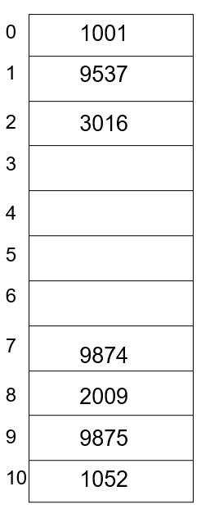
Example
insert 1052 (home bucket: 7)

Slide 25
Example
insert 1052 (home bucket: 7)

Slide 26
Example
insert 1052 (home bucket: 7)
next element in bucket 3 with probability = ?

Slide 27
Hash Functions - Numerical Values
Consider: h(x) = x%16
poor distribution, not very random
depends solely on least significant four bits of key
Better, mid-square method
if keys are integers in range 0,1,…,K , pick integer C such that DC² about equal to K², then
h(x) = ⎣x²/C⎦ % D
extracts middle r bits of x², where 2^{r}=D (a base-D digit)
better, because most or all of bits of key contribute to result

Slide 28
Hash Function – Strings of Characters
Folding Method:
int h(String x, int D) {
int i, sum;
for (sum=0, i=0; i<x.length(); i++)
sum+= (int)x.charAt(i);
return (sum%D);
}
sums the ASCII values of the letters in the string
ASCII value for “A” =65; sum will be in range 650-900 for 10 upper-case letters; good when D around 100, for example
order of chars in string has no effect

Slide 29
Open Hashing
Each bucket in the hash table is the head of a linked list
All elements that hash to a particular bucket are placed on that bucket’s linked list
Records within a bucket can be ordered in several ways
by order of insertion
by key value order
by frequency of access order

Slide 30
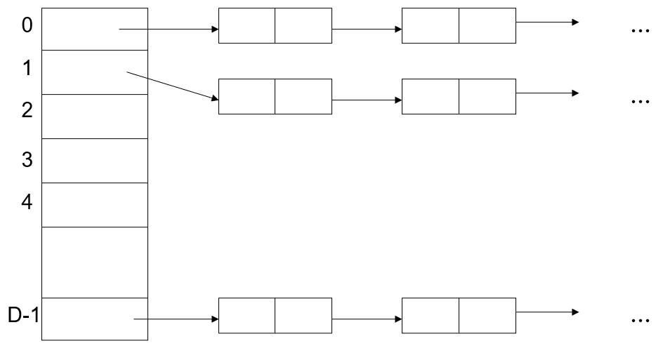
Open Hashing Data Organization

Slide 31
Analysis
Open hashing is more appropriate when the hash table is kept in main memory, implemented with a standard in-memory linked list
We hope that number of elements per bucket roughly equal in size, so that the lists will be short
If there are n elements in set, then each bucket will have roughly n/D
If we can estimate n and choose D to be roughly as large, then the average bucket will have only one or two members

Slide 32
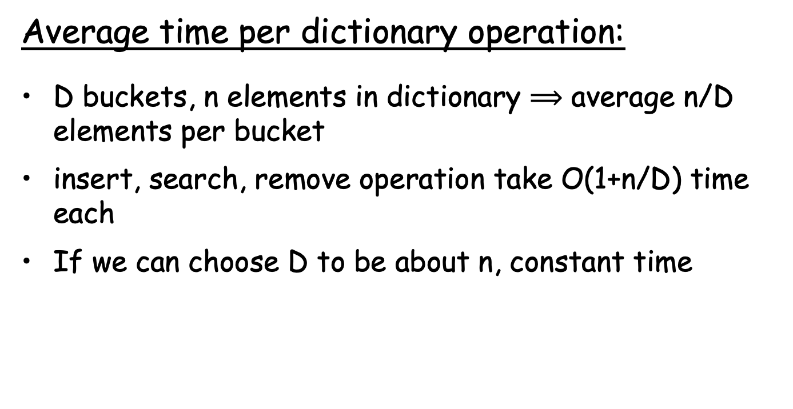
Analysis
Average time per dictionary operation:
D buckets, n elements in dictionary $⟹$ average n/D elements per bucket
insert, search, remove operation take O(1+n/D) time each
If we can choose D to be about n, constant time

Slide 33
Comparison with Closed Hashing
Worst case performance is O(n) for both
Number of operations for hashing (how many probes)
23 6 8 10 23 5 12 4 9 19
D=9
h(x) = x % D

Slide 34
Practice
Draw the 11 entry hashtable for hashing the keys 12, 44, 13, 88, 23, 94, 11, 39, 20 using the function (2i+5) mod 11 with
(1) closed hashing, linear probing
(2) open hashing, linked list

